Slide 1

Red Wine Quality
By: Gandhimathi & Valli
Red Wine Quality
By: Gandhimathi & Valli

Slide 2
DATA SOURCE:
Number of observations: 1600 Rows & 12 Columns
Independent Variable : There are 11 Independent variables like fixed acidity,volatile acidity,
citric acid, sugar content, chlorides, free sulfur dioxide, total sulfur dioxide, density,pH,
sulfates,alcohol percentage.
Dependent Variable: Quality ( score between 0 and 10)
Data Source: https://www.kaggle.com/datasets/uciml/red-wine-quality-cortez-et-al-2009/code

Slide 3
Question & Hypothesis
What chemical components significantly affect the quality of red wine?
Hypotheses for the Study:
Null Hypothesis (H₀): No chemical components (independent variables) have significant impact on the quality score of red wines.
B1 = 0
Alternative Hypothesis (H₁): There is a significant relationship between the chemical components and the quality score of red wines, indicating specific attributes influence perceived quality. B1 ≠ 0

Slide 4
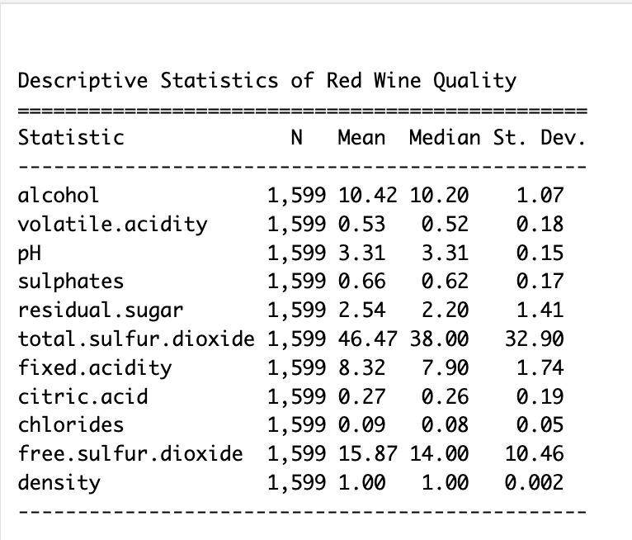
Descriptive Statistics
Balanced Acidity: Red wines exhibit a balanced acidity profile, with stable pH levels (mean = 3.31) indicating a well-distributed acidity. Volatile acidity adds to the balance (mean = 0.53) with low variability (st. dev. = 0.18).
Alcohol Consistency: The dataset reflects a moderate consistency in alcohol content (mean = 10.42%) among red wines, contributing to a stable and predictable element in their composition.
Sugar and Sulphates Variation: Notable variations exist in residual sugar content (mean = 2.54) with a right-skewed distribution, while sulphates show a moderate concentration (mean = 0.66) with a right-skewed trend. These insights offer a glimpse into the diverse chemical composition of red wines.

Slide 5
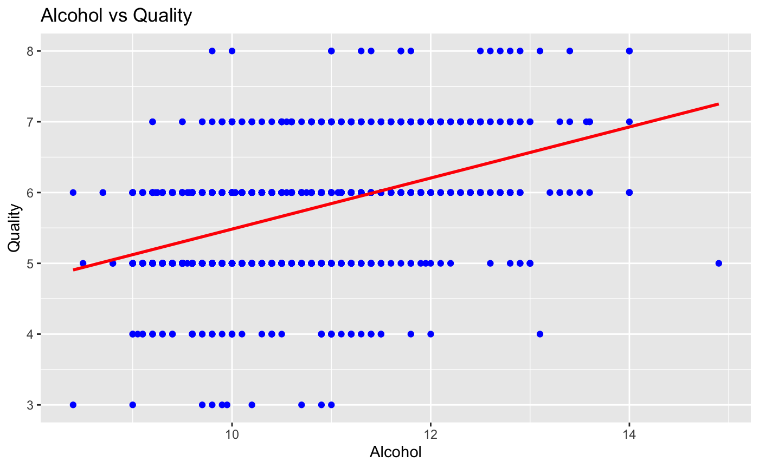
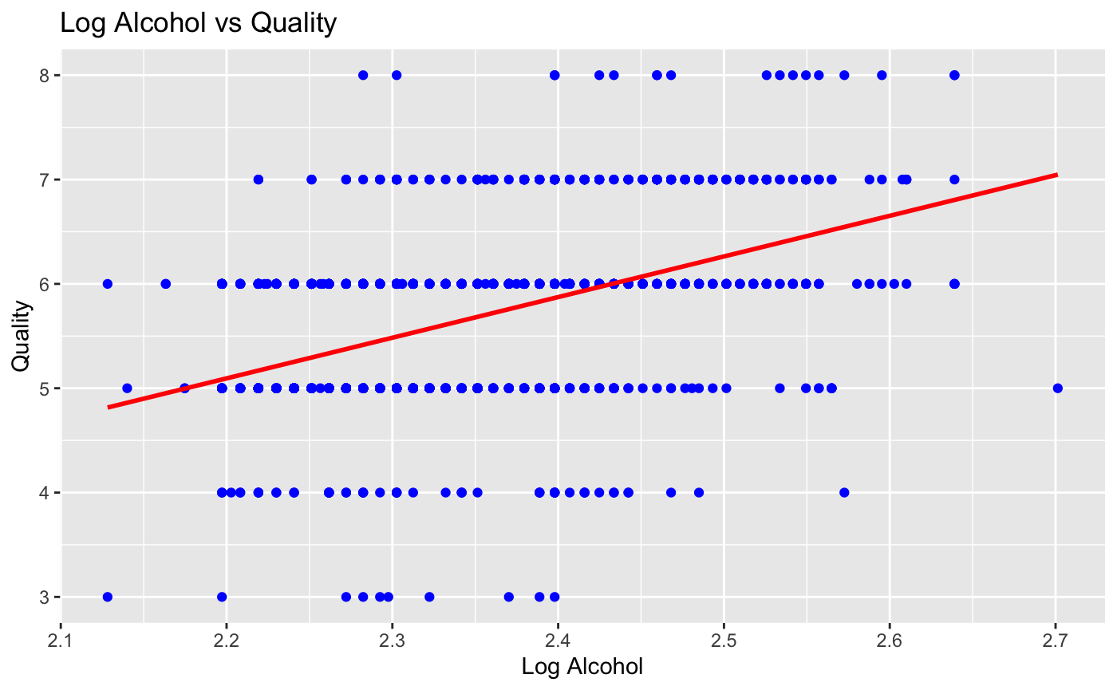

Slide 6
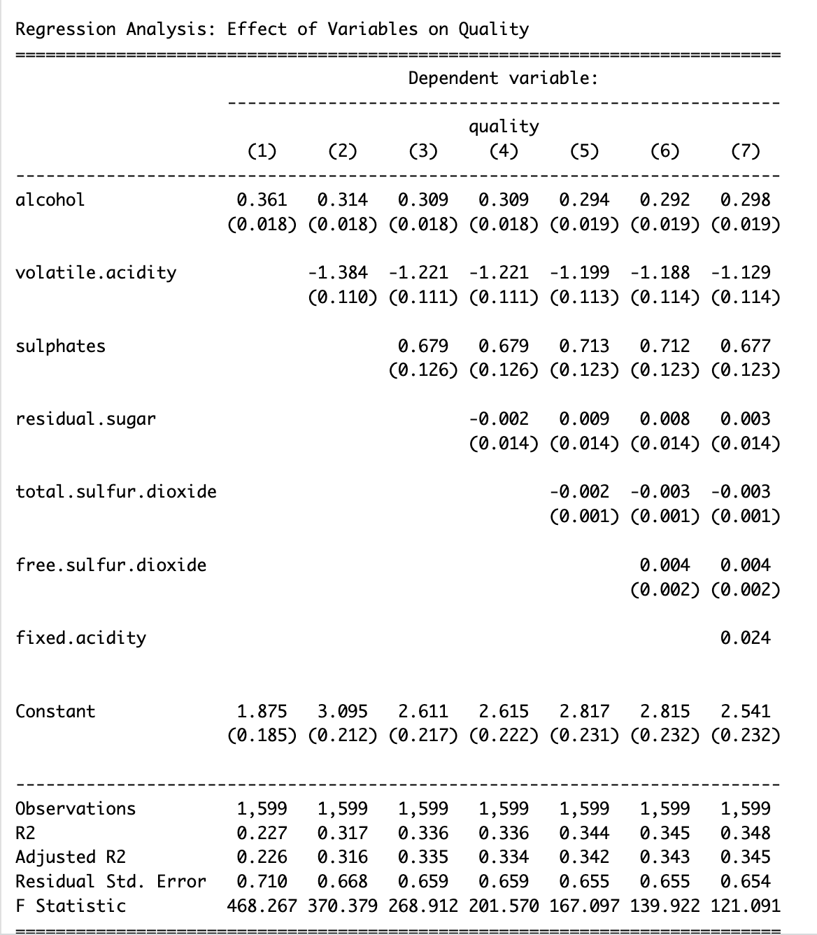
Baseline Regression Model
Positive effect on quality : +Alcohol, sulphates, free sulfur, fixed acidity
Negative : -Volatile acidity, residual sugar , total sulfur
R2 : Improves as more variables are added.
Only 34.8% variation in quality is explained in model 7, therefore there are other factors outside of this model that play a significant role
Rstd error : decreases as more variables are added, indicating a better fit

Slide 7
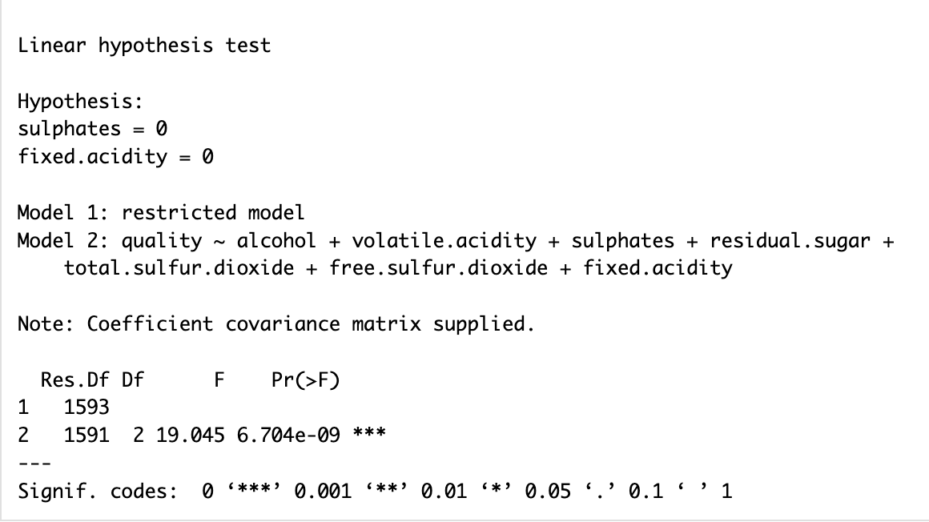
2 Models :
To predict the significance on wine quality
Restricted ( sulphates , fixed acidity coeff = 0)
Unrestricted - all variables
Since F stat is higher and it suggests model 2 is better than model 1.
Low P value - suggests that both are key predictors , and we can reject the null hypothesis.

Slide 8
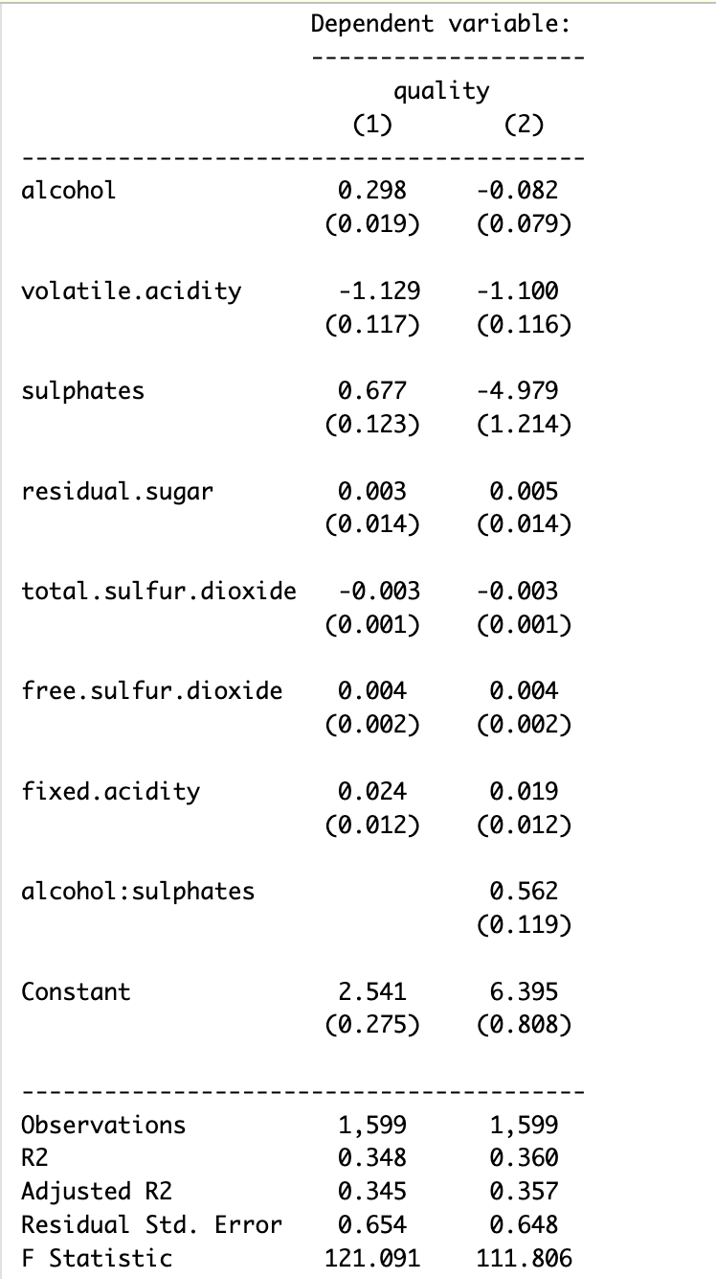
Alternative Specifications
Interaction Term:
"alcohol:sulphates" (0.562, p = 0.119)
Interpretation:
Positive coefficient suggests synergy.
Joint effect enhances wine quality.
Model Fit Improvement:
R-squared increased from 0.348 to 0.360.
Conclusion:
Joint influence of alcohol and sulphates significantly enhances wine quality.

Slide 9
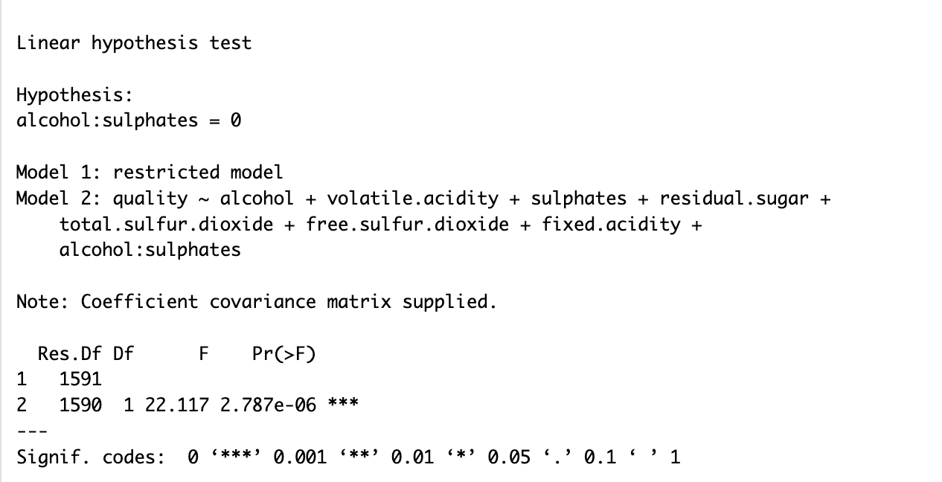

Slide 10
Internal and External Validity Threats
Internal Validity Threats:
Selection Bias in Data Collection:The dataset may primarily include wines from a certain price range or from prestigious vineyards, it may not accurately represent the full diversity of wines available in the market.
Confounding Variables: Factors like vineyard location or grape variety, if not included, could confound the relationship between the variables (like alcohol content, acidity) and wine quality.
External Validity Threats:
Different Conditions: The effect of variables like alcohol content on wine quality could vary under different production methods, storage conditions, or consumer preferences, Climate conditions can alter the relationship.
Measurement Error: For example, if the quality of wine is not measured consistently, or if there is error in measuring variables like alcohol or sulphate content, it can lead to incorrect conclusions about their effects.

Slide 11
Conclusion
The introduction of the interaction term between 'alcohol' and 'sulphates' in Model 2 significantly changes the influence of these individual factors on quality, this makes 'alcohol' and 'sulphates' individually less influential while their interaction is positively significant.
Most variables are statistically significant predictors of wine quality, with 'alcohol:sulphates' having a positive effect, suggesting a combined impact on quality.
Chemical components significantly affect the quality of red wine are alcohol, sulphates and volatile acidity

